Slide 1

Computing for the Disabled

Slide 2
Definition and Importance of Adaptive Technology
Also known as assistive technology
Use of any item, equipment or system to increase and improve functional capabilities for individuals with disabilities.
Importance: Help people with disabilities

Slide 3
History of Adaptive Technology
The field of adaptive technology has been around for at least 20 years
Universally used technology began as assistive technology
Other general use technology were later adapted to help people with disabilities
Notes:
Example is the telephone which was developed to help people with hearing disability
Example is the voice synthesizer technology which is been developed

Slide 4
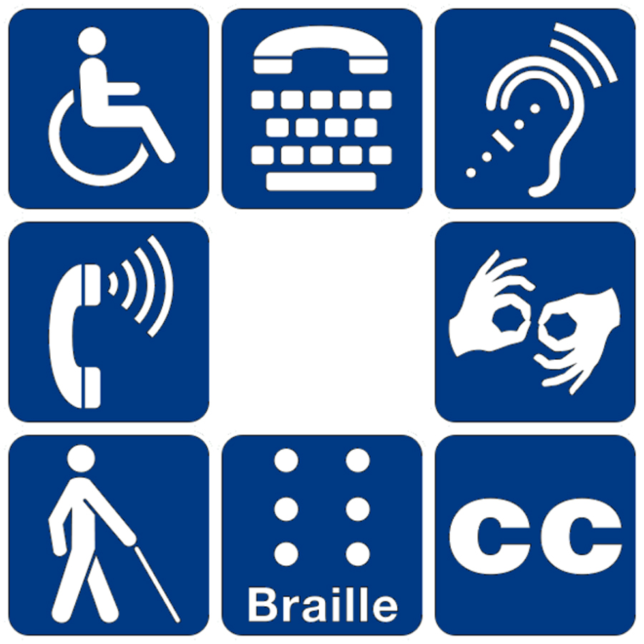
Types of disabilities
Learning/Cognitive
Visual
Physical/Motor
Hearing

Slide 5

Vision
When we think of visual disabilities, what comes to mind immediately is blindness.
While a great deal of accessibility efforts are centered on blindness, there are other vision issues that are considered in the standards.
low vision
color blindness
other conditions such as strabismus, tunnel vision, glaucoma

Slide 6


Learning/Cognitive
Learning disorders: dyslexia, dysgraphia,
Cognitive disorders: brain injury, autism, dementia
Most difficult to adapt for since there is so much variation

Slide 7
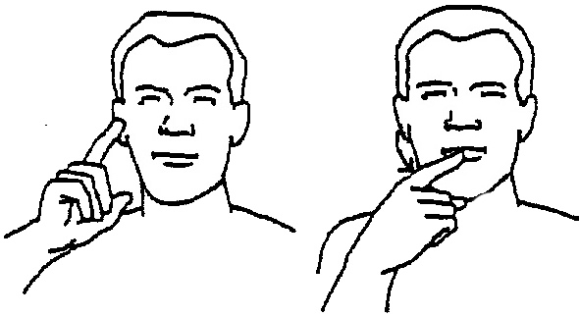
Hearing/Speech
Deaf
Hard of Hearing
Difficulty with speech

Slide 8
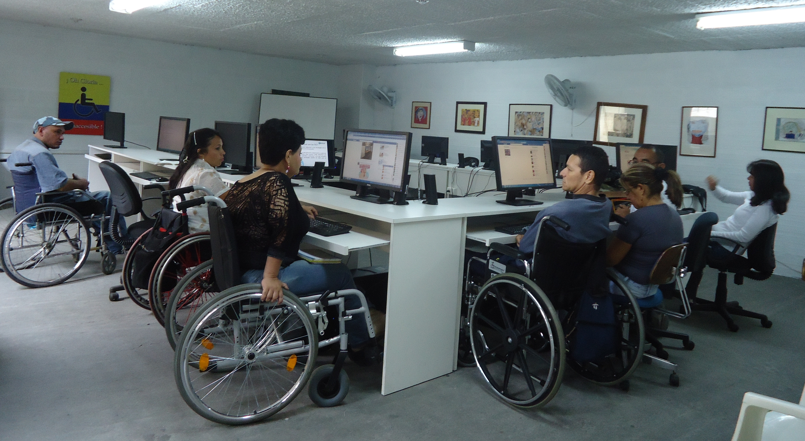
Physical/motor
Little or no control of hands
Injury or condition

Slide 9
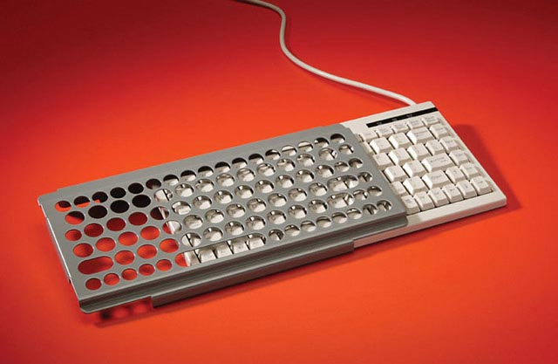
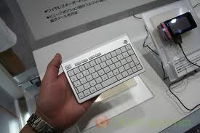
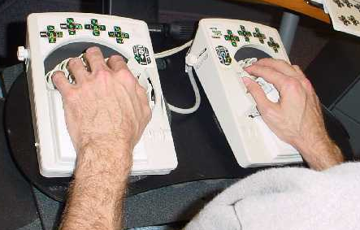
Adaptive keyboards
Keyguards allow hands to rest on keys
Mini-keyboards minimize hand motion
Datahand uses finger movement only…
Notes:
Datahand image used with permission from http://www.datahand.com

Slide 10
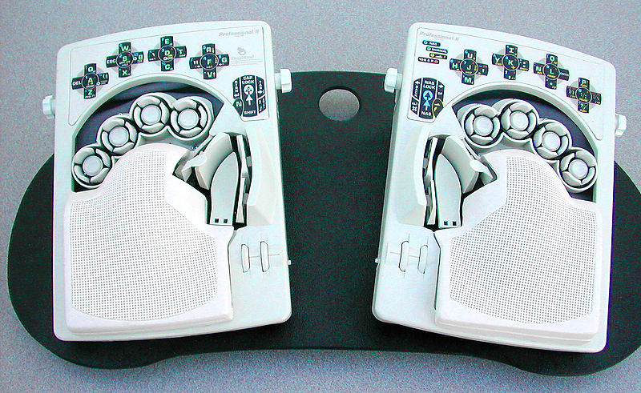
Datahand
The keyboard consists of two completely separate "keyboards", one for the left hand and one for the right, that are molded to rest your hands on
Each finger activates five buttons
There are three primary modes all together: letters, number and symbols, and function / mouse mode.
Notes:
Datahand image used with permission from http://www.datahand.com

Slide 11
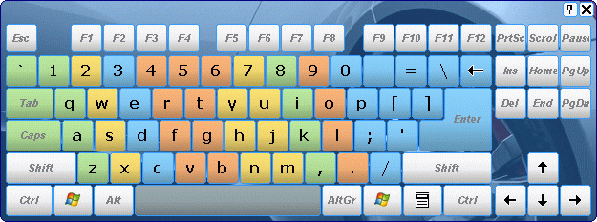
On-screen keyboard
Allows all keyboard functions to be accomplished by a mouse or switch

Slide 12
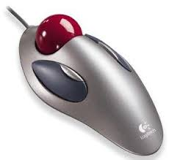
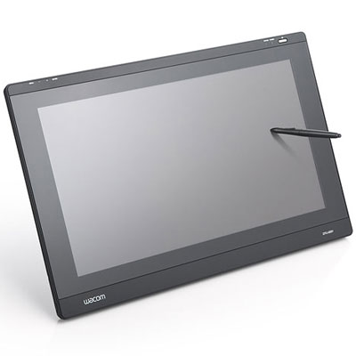
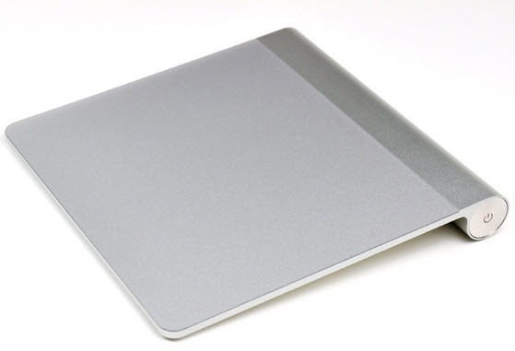
Alternatives of mouse
Trackball
Trackpad
Graphics tablet

Slide 13
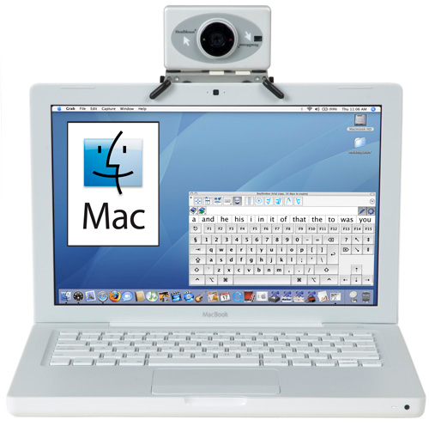
Head Mouse
HeadMouse Extreme replaces a standard computer mouse for people who cannot use their hands.
It operates from the top of a computer monitor, laptop computer and measures the user's head movements.

Slide 14
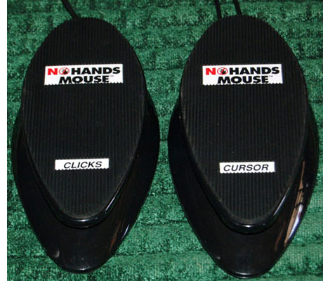
Foot mouse
Mouse substitutes that use foot pedals are nothing new for carpal tunnel syndrome sufferers or others looking to control a computer with their feet.
One pedal handles the pointer's movement, while the other does the clicking.
Notes:
Footmouse image used with permission from http://www.footmouse.com

Slide 15
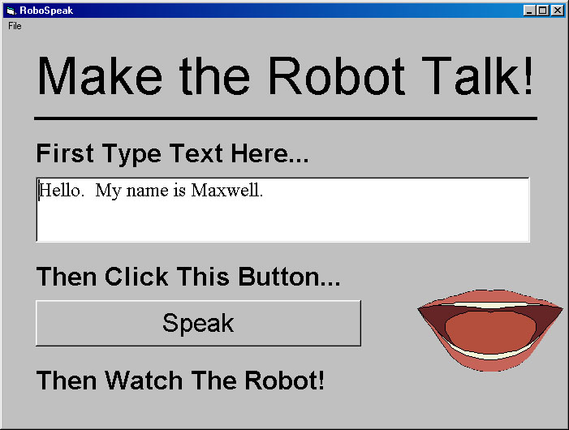
Screen Readers & Speech Synthesizer
Screen reader is software that works together with a speech synthesizer to read aloud everything contained on a computer screen, including icons, menus
attempts to identify and interpret what is being displayed on the screen
sometime used by persons with developmental disabilities

Slide 16
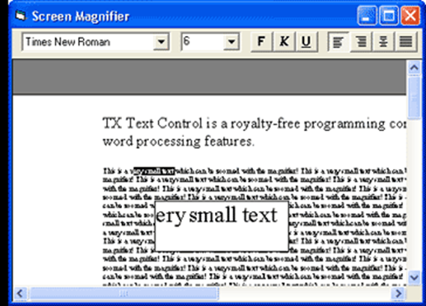
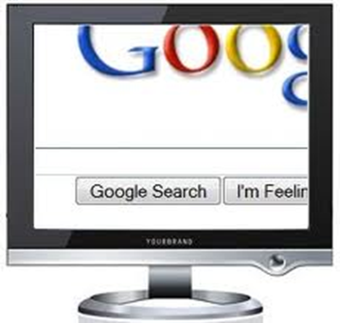
Magnifier (Lupe)
Utility that magnifies whatever is underneath your cursor

Slide 17

Brailed keyboards
They allow them to use a keyboard without the need to see the keys.
They use raised dots to represent different letters and words.

Slide 18
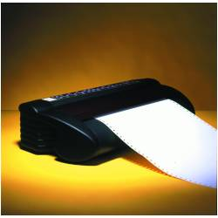
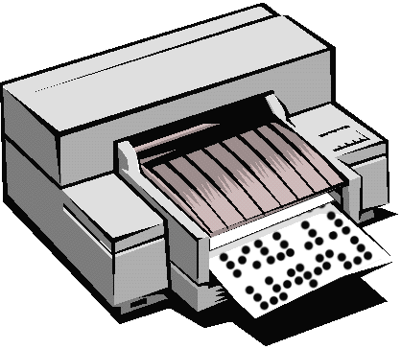
Braille Printers (Embosser)
Using special translation software it will print a document by punching dots onto special Braille paper, which is thicker and more costly than normal paper.
This hardware allows visually impaired and blind people to have hard copies of text but in a language they can understand if they are familiar with Braille.

Slide 19
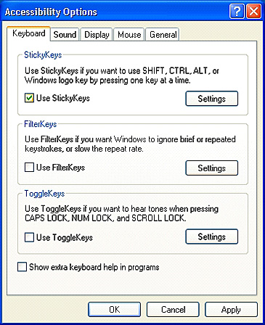
Accessibility features in OS
Windows & Mac
Sticky keys / filter keys
Screen magnifiers
Mouse & cursor control
Keyboard navigation
Visual alert
High contrast settings.
Windows
On-screen keyboard
Mac
Speech recognition for specific commands

Slide 20
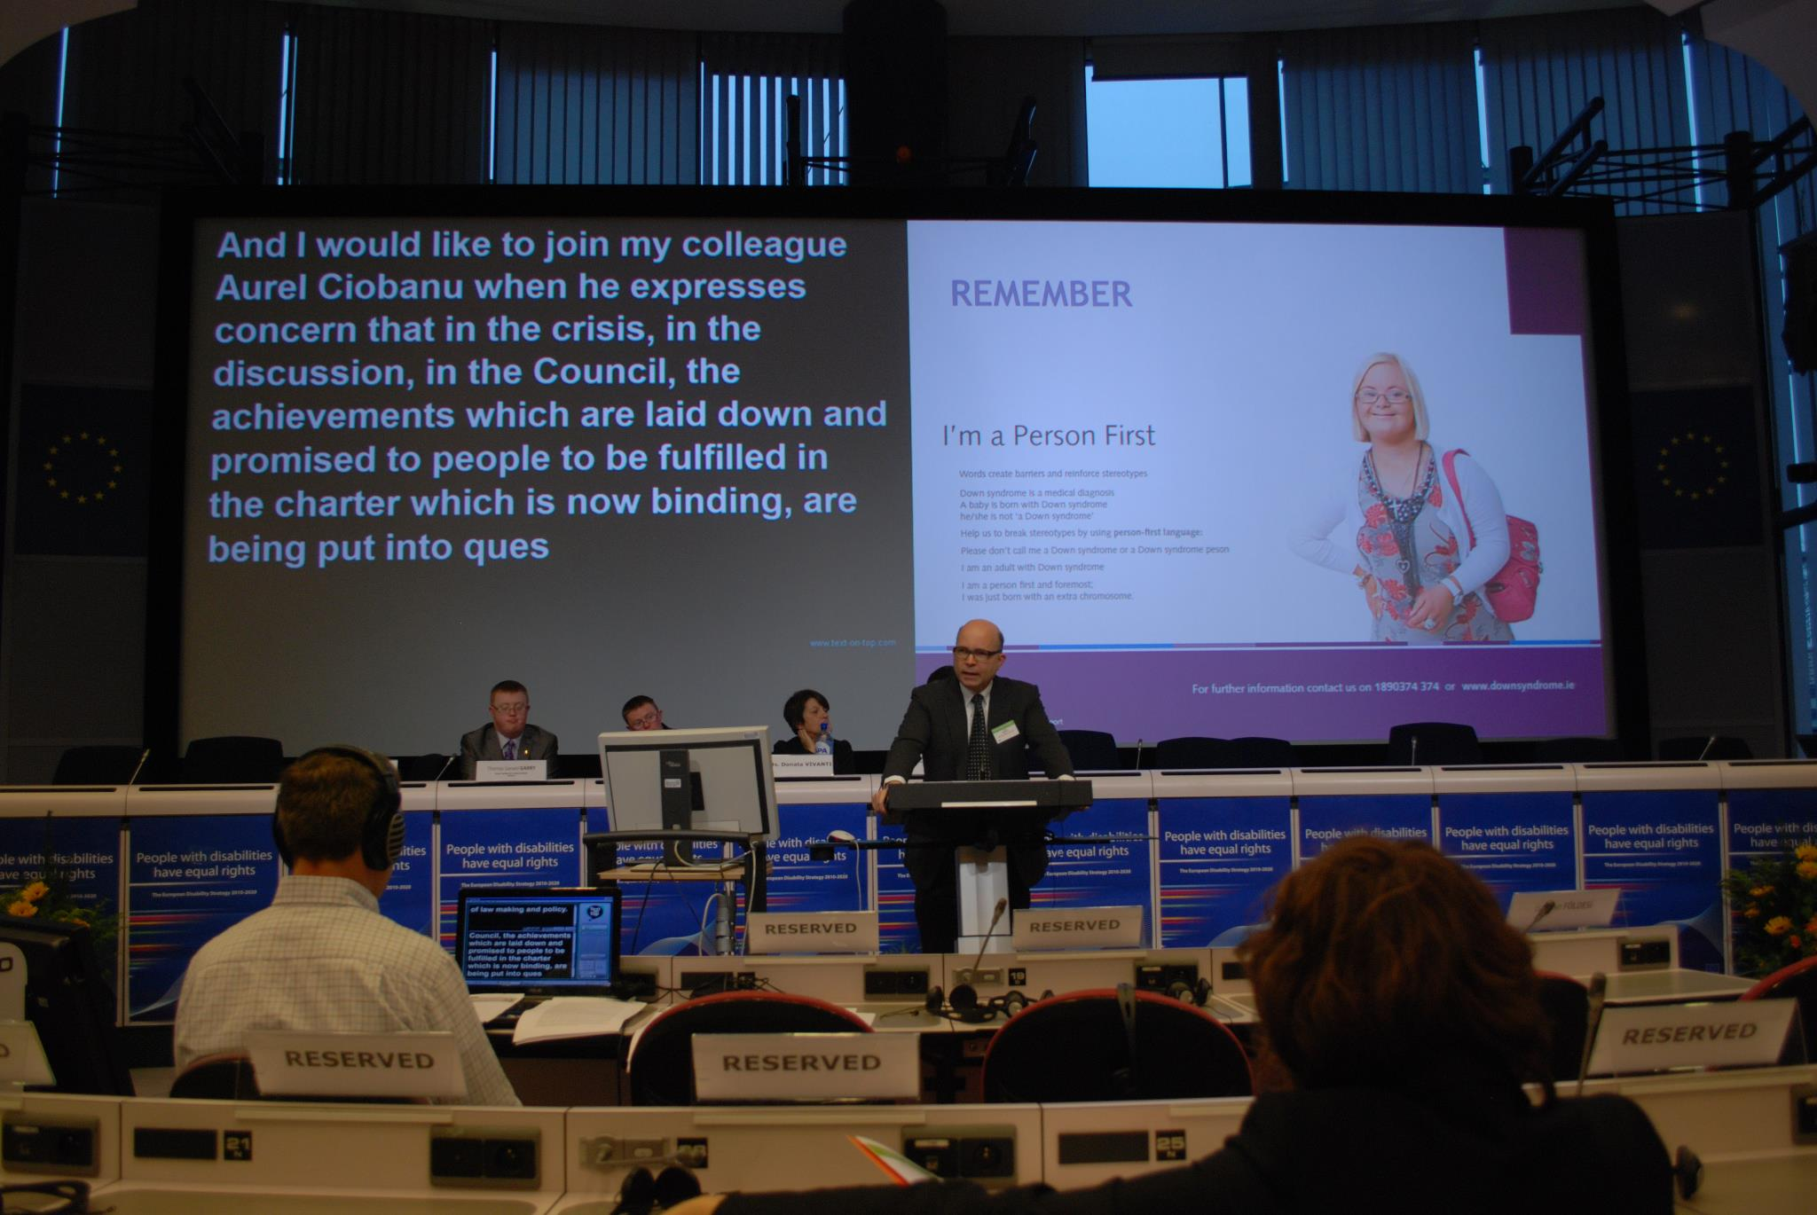
Captioning
Aid for hearing impaired
Also helps those with comprehension problems
“closed” means that the captions are displayed at the option of the viewer
“open” refers to captions that can’t be turned off or hidden

Slide 21
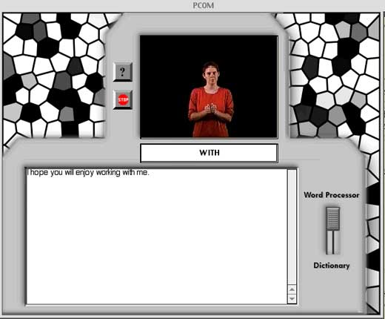
Personal Communicator
A Tool for Learning and Communicating in American Sign Language and English
Notes:
df

Slide 22
Technology for people with Writing or Motor disability
Onscreen keyboard
Abbreviations/Expansions
Word prediction/Completion
Voice Input Applications
Keyboard Modifications and shortcuts
Mouse Enhancers

Slide 23
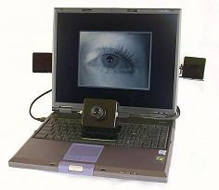
EyeGaze Tracking System
Place the mouse pointer simply by looking at the desired location. - Click with an eye blink, a hardware switch, or by staring

Slide 24
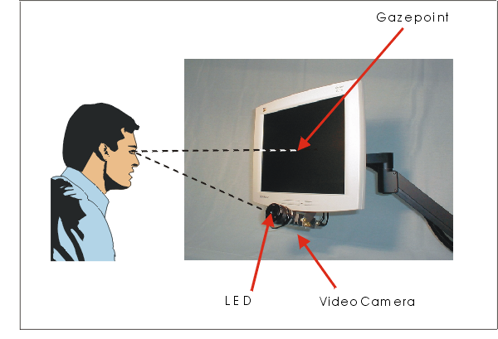
How does the EyeGaze System work?
a specialized video camera mounted below the monitor observes one of the user's eyes
Sophisticated image processing software in the EyeGaze System's computer continually analyzes the video image of the eye and determines where the user is looking on the screen.
uses infrared light to illuminate the eye

Slide 25
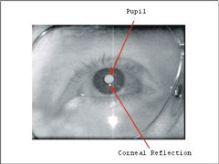
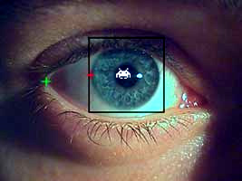
How does the EyeGaze System work?
Eyegaze System uses the Pupil-Center/Corneal-Reflection method to determine the eye's gaze direction.
Specialized image-processing software in the Eyegaze computer identifies and locates the centers of both the pupil and corneal reflection.

Slide 26
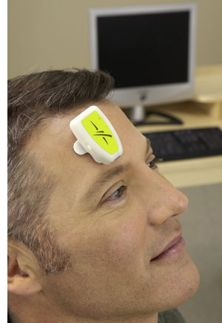
Muscle messages: The Impulse system
AbleNet Impulse system For amputated, paralyzed or impaired people.
a small device fitted to the user's skin that uses electromyography technology to sense, amplify and transmit the small electrical impulses sent from the brain to the muscle. It works with many different areas of the body, including the neck and face, and can turn a wink or smile into a click.
Also the user can navigate a PC's applications, surf the Web and type with an on-screen keyboard.

Slide 27
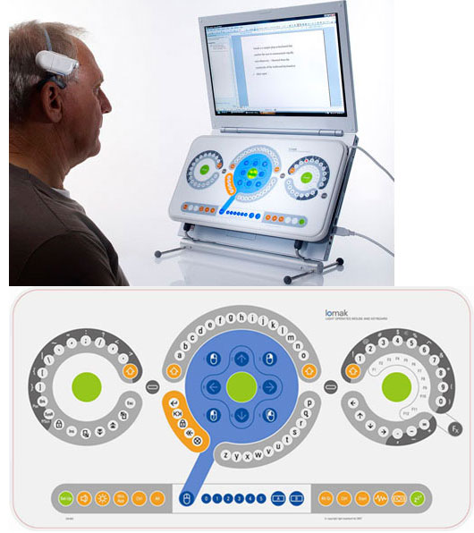
Light-operated computing: Lomak
A head-mounted device with a laser beam
a keyboard replacement that has 105 photo-sensitive spots arranged in circles that correspond to letters and numbers, punctuation and mouse movements.

